Slide 1
ARM Software Track
Arnab Basu
Bhupesh Sharma
Prabhakar Kushwaha
Shaveta Leekha

Slide 2
Agenda
Track 1 : 8th Oct 2013
ARMv7 Recap
ARM Procedure Call Standard (APCS)
ARM Functional Model
ARM Bring up/Boot up (Simple hardware)
ARM Bring up/Boot up (Complex hardware)
Track 2 : 17th Oct 2013
ARM Instruction Set
ARM Interrupt Model
ARM Development Tools
RealView ICE

Slide 3
TRACK 1

Slide 4
Track 1 Agenda
ARMv7 Recap
ARM Procedure Call Standard (APCS)
ARM Functional Model
ARM Bring up/Boot up (Simple hardware)
ARM Bring up/Boot up (Complex hardware)
U-boot
Linux

Slide 5
ARM - RECAP

Slide 6
A Short Introduction – ARMv7
The ARM core (upto v7) is a 32-bit processor
Instructions treat registers as holding signed or unsigned 32-bit values
When used in relation to the ARM(upto v7):
Byte means 8 bits
Halfword means 16 bits (two bytes)
Word means 32 bits (four bytes)
Instruction Sets available in ARMv7
ARM (32 Bit Instruction Set)
THUMB (16 Bit Instruction Set, data)

Slide 7
Recap: Current State – Program Status Register
31
28
27
24
23
16
15
8
7
6
5
4
0
N Z C V Q
U n d e f i n e d
I F T mode
J
f
s
x
c
Condition code flags
N = Negative result from ALU
Z = Zero result from ALU
C = ALU operation Carried out
V = ALU operation oVerflowed
Sticky Overflow flag - Q flag
Architecture 5TE/J only
Indicates if saturation has occurred
J bit
Architecture 5TEJ only
J = 1: Processor in Jazelle state
Interrupt Disable bits.
I = 1: Disables the IRQ.
F = 1: Disables the FIQ.
T Bit
Architecture xT only
T = 0: Processor in ARM state
T = 1: Processor in Thumb state
Mode bits
Specify the processor mode

Slide 8
Processor Modes - Privileged
Determines which registers are active and access rights to the cpsr register
Each processor mode is either
privileged full read-write access to the cpsr
Abort: Entered when there is a failed attempt to access memory
Fast interrupt request: Type of interrupt level
Interrupt request: Type of interrupt level
Supervisor: Mode that the processor is in after reset, mode in which OS kernel resides
System: and version of user mode that allows full read-write access to cpsr
Undefined: used when the processor encounters an instruction that is undefined or not supported by implementation

Slide 9
Processor Modes – Non - Privileged
Non-privileged only read access to the control field in the cpsr, read-write access to the condition flags
user: used for programs and applications
User and system mode share the same register set, but are at different privilege levels

Slide 10
Processor Modes - contd
How is processor mode changed?
Processor mode changes when the processor responds to an interrupt or exception
It can also be changed by writing directly to the mode bits of the cpsr (only in privileged modes)

Slide 11
Registers
There are a total of 37 registers in the register file
30 data registers
6 process status registers (1 current PSR and 5 saved PSRs)
1 Program Counter
Register banking – registers are hidden i.e. inaccessible based on the processor mode
All privileged modes (except system) have 2 process status registers (current and saved)
User mode only has one
15 Data registers and the Program Counter are visible at a time

Slide 12
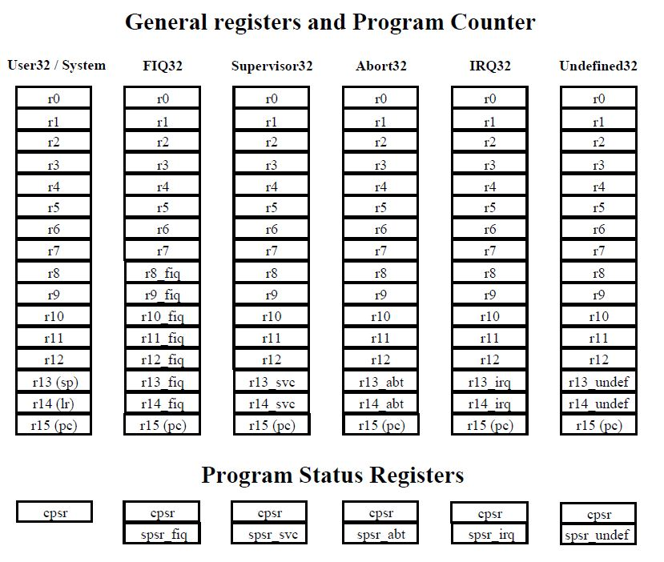
ARMv7 Register Organization
(Source: The ARM Instruction Set - ARM University Program - V1.0)

Slide 13
Special Data Registers
r0 to r13 are orthogonal i.e. any instruction that can operate on r0 can operate on all the other registers
r13 is used as the stack pointer
it is banked in all modes (except system) so each mode can have its own stack
r14 is the link register
r15 is the program counter

Slide 14
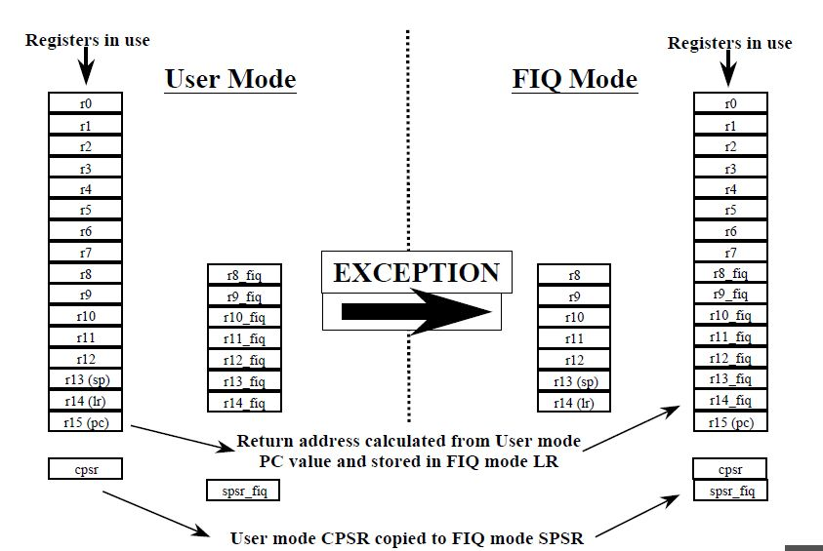
Register Banking Example
(Source: The ARM Instruction Set - ARM University Program - V1.0)

Slide 15
Exceptions
Vector Table: Address range within which the processor will jump in case an exception occurs
Specific offset within the table is determined by the interrupt
Vector table only has space for one instruction per exception
This instruction is a branch instruction to the actual handler
FIQ is placed at the end of the table so it doesn’t need to branch

Slide 16
Vector Table Placement and Structure
Vector table can be placed at 0x00000000 or 0xffff0000
The address is determined by
Either VINITHI (configuration signal)
Or V bit of System control register
Arrangement of vectors within the vector table:
Reset
Undefined Instruction
Software Interrupt
Prefetch Abort
Data Abort
IRQ
FIQ
We will go further into exception handling in another module (to be covered in Track 2)

Slide 17
Types of Context Switching
Register Banking
Hardware supported
supported in hardware and also initiated by hardware
Fast (very low Sw complexity in the simple case)
Maximum Nesting Depth is Predefined (and Limited)
Can get complex (we will discuss nested interrupts later)
Software initiated context switching using the stack
Has hardware support in some architectures (limited in ARM)
Even with Hw support, more Sw intervention required than above case
Much more flexible, nesting depth only limited by stack size
Careful management of sp required (usually handled by compiler)

Slide 18
Quiz Time
Q: How many general-purpose registers are there in the ARM 32-bit architectures?
A:
37 registers in the register file
30 data registers
6 process status registers (1 current PSR and 5 saved PSRs)
1 Program Counter
Q: How can default location Exception vector table be changed at runtime?
A:
V bit of System Control Register

Slide 19
APCS
ARM Procedure Call Standard

Slide 20
Procedures/Functions
A fragment of program to which control can be transferred that, on completing its task, returns control to its caller at an instruction following the call. a routine is the caller and a subroutine is the callee.
Routine, subroutine:
Procedure
A routine that returns no result value.
Function:
A routine that returns a result value.
Arguments
Expressions passed into a function
Parameters
Values received by the function

Slide 21
Procedures/Functions
Caller/Callee:
void func(int a, int b)
{
...
}
int main(void)
{
func(100,200);
...
}
callee
parameters
caller
arguments
Procedure A calls Procedure B
A referred to as is “calling procedure” or “caller”
B referred to as is “called procedure” or “callee”

Slide 22
Basics of Function/Procedure Call
Caller
Callee
...(use regs)
set up args
jump to function
access result
...(use regs)
access args
... compute result ...
...(use regs)
set up return value
jump back to caller

Slide 23
Why APCS?
main:
...
BL func
...
.end
callee
caller
func:
...
...
.end
How to pass arguments? By registers? By stack? By memory? In what order?

Slide 24
Why APCS?
caller
main:
@ use R5
BL func
@ use R5
...
...
.end
func:
...
@ use R5
...
...
.end
callee
@ save R5
@ save R5
@ restore R5
@ restore R5
How to pass arguments? By registers? By stack? By memory?
In what order?
Who should save R5? Caller? Callee?
We need a protocol for these.

Slide 25
Procedure/Function Call Bookkeeping
Procedure address
Return address
Arguments
Return value
Local variables

Slide 26
Register Conflicts: 2 options (A calls B)
1) Called procedure/callee (B) leaves registers the way it found them (except lr); its B’s job to save it before using it and then restore it: “callee saves”
Since B only saves what it changes, more accurate is “callee saves (what it uses)”
2) B can use any register it wants; Calling procedure/caller A must save any register it wants to use after call of B: “caller saves”
Since A knows what it needs after call, more accurate is “caller saves (if it wants to)”
Is either optimal?
=>ARM Procedure Call Standards (APCS) conventions for use of registers simplify bookkeeping

Slide 27
ARM Procedure Call Standard(APCS)
The ARM Procedure Call Standard (APCS) defined by ARM Ltd. defines how to pass function arguments and return values in ARM registers that is a set of rules for procedure entry and exit so that Object codes generated by different compilers can be linked together. It describes a contract between a calling routine and a called routine that defines:
Obligations on the caller to create a program state in which the called routine may start to execute.
Obligations on the called routine to preserve the program state of the caller across the call.
The rights of the called routine to alter the program state of its caller.
APCS defines
Use of registers
Use of stack
Mechanism for argument passing

Slide 28
APCS register usage convention

Slide 29
APCS register usage convention
Used to pass the first 4 parameters
Caller-saved if necessary

Slide 30
APCS register usage convention
Register variables, must return unchanged
Callee-saved

Slide 31
APCS register usage convention
r9 holds the static base
Address, when compiling for read-write
position independence (RWPI). This is the base address of the read-write data.

Slide 32
APCS register usage convention
r10 holds the stack limit address, when compiling with stack limit checking

Slide 33
APCS register usage convention
r11 holds frame pointer
Address, when compiling using a frame pointer. Only old versions of armcc use a frame pointer.

Slide 34
APCS register usage convention
A general scratch register that the function can corrupt. It is
useful as a scratch register for function veneers or other
intraprocedure call requirements.

Slide 35
APCS register usage convention
Registers for special purposes
Could be used as temporary variables if saved properly.

Slide 36
ARM Solution to Register Conflicts
Divide registers into groups
Local variables / Callee Saves registers (v1 – v8) / (r4 –r11)
Scratch registers / Argument / Caller Save registers (a1 – a4) /
(r0 – r3)
Some caller saves (if wants) and some callee saves (if used)
Caller (A) save/restore scratch / argument (a1 – a4) if needs them after the call; also lr ➔ callee can use (a1 – a4) and lr
Callee (B) must save/restore local variables / callee saves registers (v1 – v8) if it uses them ➔ caller can leave them unsaved

Slide 37
Register Conventions
Register Conventions: A set of generally accepted rules as to which registers will be unchanged after a procedure call (bl) and which may be changed.
Three views of registers a1 – a4
a1 – a4 :
Change. These are expected to contain new return values.
Or
a1 – a4 :
Change. These are volatile argument registers.
Or
a1 – a4 :
Change. They’re called scratch: any procedure may change them at any time.

Slide 38
Register Conventions
v1 – v8 :
No Change. Very important, that’s why they’re called callee saves registers / local variable. If the callee changes these in any way, it must restore the original values before returning.
sp:
No Change. The stack pointer must point to the same place before and after the bl call, or else the caller won’t be able to restore values from the stack.
lr:
Change. The bl call itself will change this register.
Ip:
Change. In most variants of APCS ip is an scratch register.

Slide 39
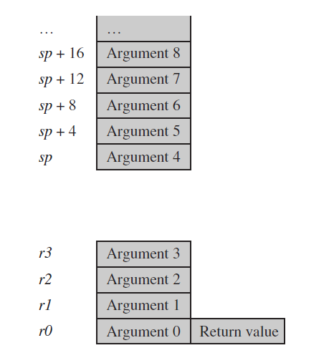
Argument passing and Register Allocation
The first point to note about the procedure call standard is the four-register rule.
Functions with four or fewer arguments are far more efficient to call than functions with five or more arguments.The first four word arguments are passed through R0 to R3.
Remaining parameters are pushed into stack in the reverse order.
Procedures with less than four parameters are more effective.
Return value
One word value in R0
A value of length 2~4 words (R0-R1, R0-R2, R0-R3)

Slide 40
Argument passing and Register Allocation(Example)
Version 1
Version 2
char *queue_bytes_v1(
char *Q_start, /* Queue buffer start address */
char *Q_end, /* Queue buffer end address */
char *Q_ptr, /* Current queue pointer position */
char *data, /* Data to insert into the queue */
unsigned int N) /* Number of bytes to insert */
{
do
{
*(Q_ptr++) = *(data++);
if (Q_ptr == Q_end)
{
Q_ptr = Q_start;
}
} while (--N);
return Q_ptr;
}
typedef struct {
char *Q_start; /* Queue buffer start address */
char *Q_end; /* Queue buffer end address */
char *Q_ptr; /* Current queue pointer position */
} Queue;
void queue_bytes_v2(Queue *queue, char *data, unsigned int N)
{
char *Q_ptr = queue->Q_ptr;
char *Q_end = queue->Q_end;
do
{
*(Q_ptr++) = *(data++);
if (Q_ptr == Q_end)
{
Q_ptr = queue->Q_start;
}
} while (--N);
queue->Q_ptr = Q_ptr;
}
The second version has only three function arguments rather than
five. Each call to the function requires only three register setups. This compares with four
register setups, a stack push, and a stack pull for the first version. There is a net saving
of two instructions in function call overhead. There are likely further savings in the callee
function, as it only needs to assign a single register to the Queue structure pointer, rather
than three registers in the nonstructured case.

Slide 41
Procedure/Function Call Bookkeeping
Procedure address
Return address
Arguments
Return value
Local variables
Specified by ARM Procedure Call Standards (APCS) conventions
Registers for functions
→ lr = r14
→ a1, a2, a3, a4
→ a1
→ v1, v2,v3,v4,v5,v6,v8
APCS (ARM Procedure Call Standard)
r0-r3/a1-a4 pass parameters into procedure. Extra parameters are put on stack frame.
r0/a1 holds return value.
r4-r7 hold register values.
r11 is frame pointer, r13 is stack pointer.
r10 holds limiting address on stack size to check for stack overflows.

Slide 42
Callees’ & Callers’ Rights (Summary)
Callees’ Right
Right to use a1 – a4 / r0 – r3 registers freely
Right to assume args are passed correctly in a1 – a4 / r0 – r3
Callers’ Rights
Right to use v1 – v8 / r4 – r11 registers without fear of being overwritten by Callee
Right to assume return values will be returned correctly in a1 – a4 / r0 – r3

Slide 43
Example (Parameter passing)
/* A program to see how arm assembler implements long Parameter lists */
void do_it(int, int, int, int, int, int);
main()
{
int i,j;
i = 10;
j = 20;
do_it(1,2,3,4,5,6);
}
void do_it(int a, int b, int c,int d, int e, int f)
{
int i,j;
i = 10;
j = a + b + c + d + e + f;
}

Slide 44
Example (Parameter passing)
.text .align 2 .global main .type main,function main: @ args = 0, pretend = 0, frame = 8 @ frame_needed = 1, current_function_anonymous_args = 0 mov ip, sp stmfd sp!, {fp, ip, lr, pc} sub fp, ip, #4 sub sp, sp, #16 mov r3, #10 str r3, [fp, #-16] mov r3, #20 str r3, [fp, #-20] mov r3, #5 str r3, [sp, #0] mov r3, #6 str r3, [sp, #4] mov r0, #1 mov r1, #2 mov r2, #3 mov r3, #4 bl do_it .L2: ldmea fp, {fp, sp, pc}
Variable i
Variable j
Parameter 5
}
Parameter 6
Parameters 1 - 4

Slide 45
Example (Parameter passing)
.align 2 .global do_it .type do_it,function do_it: @ args = 8, pretend = 0, frame = 24 @ frame_needed = 1, current_function_anonymous_args = 0 mov ip, sp stmfd sp!, {fp, ip, lr, pc} sub fp, ip, #4 sub sp, sp, #24 str r0, [fp, #-16] str r1, [fp, #-20] str r2, [fp, #-24] str r3, [fp, #-28] mov r3, #10 str r3, [fp, #-32] ldr r3, [fp, #-16] ldr r2, [fp, #-20] add r3, r3, r2 ldr r2, [fp, #-24] add r3, r3, r2 ldr r2, [fp, #-28] add r3, r3, r2 ldr r2, [fp, #4] add r3, r3, r2 ldr r2, [fp, #8] add r3, r3, r2 str r3, [fp, #-36] .L3: ldmea fp, {fp, sp, pc}
}
Saving parameters

Slide 46
“And in Conclusion …’’
ARM SW convention divides registers into those calling procedure save/restore and those called procedure save/restore
Assigns registers to arguments, return address, return value, stack pointer
To implement a function efficiently
minimize the number of spilled variables
ensure that the most important and frequently accessed variables are stored in registers
For Efficient Register Allocation
Try to limit the number of local variables in the internal loop of functions to 12. The
compiler should be able to allocate these to ARM registers.
You can guide the compiler as to which variables are important by ensuring these
variables are used within the innermost loop.
Calling Functions Efficiently
Try to restrict functions to four arguments. This will make them more efficient to
call. Use structures to group related arguments and pass structure pointers instead of
multiple arguments.

Slide 47
Quiz Time
Q: What does APCS stand for?
A:
ARM Procedure Calling Sequence
Q: Efficient register allocation - How many local variables a function should use without spillage?
A:
12 ( 4: argument + 8: local variables)
Q: Efficient function calling - How many arguments should be passed to a function?
A:
4

Slide 48
ARM Bring up/Boot up in u-boot

Slide 49
Track 1 Agenda
ARMv7 Recap
ARM Procedure Call Standard (APCS)
ARM Functional Model
ARM Bring up/Boot up (Simple hardware)
ARM Bring up/Boot up (Complex hardware)
U-boot
Linux

Slide 50
ARM Functional Model
Notes:
Why we requires this functional model

Slide 51
ARM virtual platforms
ARM provides functionally accurate virtual hardware development platforms and tools to enable early software development and debugging:
Fast Model Library
Model Debugger
Enables debugging of the source code for the model
Collection of pre-build models of ARM processor core.
Used for software development, debugging, and analysis.
Programmer’s View model Library
CADI Debug API
Collection of standard IP blocks that can be interconnected to create a new SoC model.
Interface used by the Model Debugger / other ARM debuggers / 3^{rd -} party debuggers to enable them to debug applications.

Slide 52
ARM Fixed Virtual Platform (FVP) types
Fast Models
CADI / MTI interfaces.
Foundation
Models
Free of charge.
Linux + GNU maintainers, apps developers etc
Debug via GDB (no CADI / MTI).
Limited platform support (Most IPs are ARM IPs).
Premium products.
Extensible, scalable.
Flexible virtual platform for ARM based SoCs.

Slide 53
Creating a custom virtual platform
Fast Model Portfolio IPs
(GICv3)
System Canvas
Fast Model CPU model
(ARMv8 CPU – Cortex A57)
Custom Virtual Platform
Custom modeling Language
Custom
IPs
(FSL DUART IP)
MTI, CADI (Debug Interfaces)
SystemC exported custom Virtual Platform
System C

Slide 54
ARM Bring up/Booting Flow

Slide 55
Simple Embedded System
Boot up flow

Slide 56
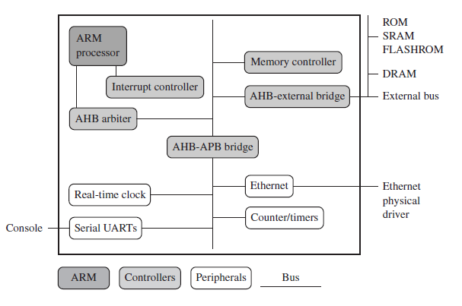
ARM based Simple Embedded System

Slide 57

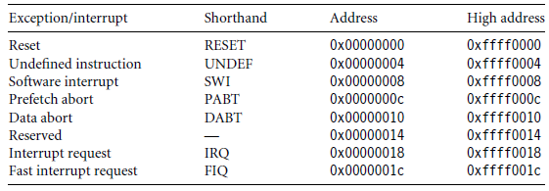
System View @ Reset

Slide 58
Execution Flow on Power On Reset
Take the Reset exception
Start initializing the hardware
Remap memory
Initialize communication hardware
Boot loader – copy payload & relinquish the control

Slide 59

System View @ Run Time

Slide 60
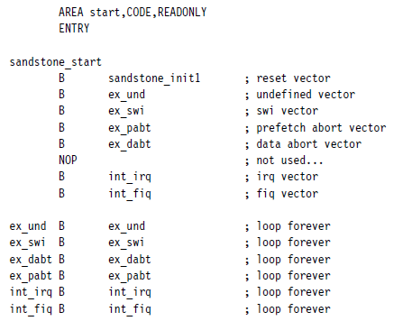
Step 1: Take the Reset Exception
Step 1: Take the Reset Exception
Take the Reset exception
Start initializing the hardware
Remap memory
Initialize communication hardware
Boot loader – copy payload & relinquish the control

Slide 61
Step 2: Start Initializing the Hardware
Step 2: Start Initializing the Hardware
Initialize hardware by setting up system registers
Init Core
Invalidate Cache
Timer init, etc
Take the Reset exception
Start initializing the hardware
Remap memory
Initialize communication hardware
Boot loader – copy payload & relinquish the control
Notes:
Init Core
- mode, interrupts, invalidation of cache, MMU disable etc
- init internal timer required for udelay etc

Slide 62
Step 3: Remap Memory
Step 3: Remap Memory
The platform starts with a known Memory map(default)
Take the Reset exception
Start initializing the hardware
Remap memory
Initialize communication hardware
Needs to remap the system with respect to its execution view
Init SRAM
Remap ROM
Boot loader – copy payload & relinquish the control

Slide 63
Step 4: Initialize Communication Hardware
Step 4: Initialize Communication Hardware
Configure a serial port
Output a standard text
If a serial cable is attached to the board, output can be seen on the console
Take the Reset exception
Start initializing the hardware
Remap memory
Initialize communication hardware
Boot loader – copy payload & relinquish the control

Slide 64
Step 5: Bootloader—Copy Payload and Relinquish Control
Step 5: Bootloader—Copy Payload and Relinquish Control
Copy rest of boot loader to SRAM
Transfer control to SRAM
Initialize rest of the hardware for eg. Ethernet, RTC
And Finally
Wait for user interface or boot linux
Take the Reset exception
Start initializing the hardware
Remap memory
Initialize communication hardware
Boot loader – copy payload & relinquish the control

Slide 65
Complex Embedded System
Boot up flow

Slide 66
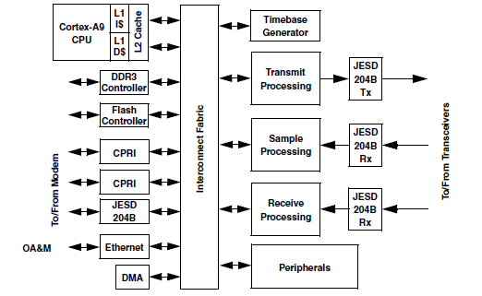
DFE: D4400

Slide 67
System Memory View
Start | End | Size | Region
0x0000_0000 | 0x0000_3FFF | 16 Kbytes | ROM (256 Kbytes total)
0x0000_4000 | 0x0040_3FFF | 4Mbytes | Reserved
0x0040_4000 | 0x0043_FFFF | 240 Kbytes | ROM (256 Kbytes total)
0x0101_4100 | 0x0101_41FF | 256 Bytes | ARM GIC interface
0x0101_4200 | 0x0101_42FF | 256 Bytes | Global timer
0x0101_5000 | 0x0101_5FFF | 4 Kbytes | ARM GIC interrupt distributor
… | …. | …. | ….
0x0600_0000 | 0x0600_003F | 128 bytes | QSPI AHB mapped space
0x0800_0000 | 0x0FFF_FFFF | 128Mbytes | QSPI SPI flash
0x1000_0000 | 0x1000_FFFF | 64 Kbytes | OCRAM (64 KB Total)
0x1090_0000 | 0x1090_3FFF | 16 Kbytes | L2 Cache Controller (L2CC)
0x3000_0000 | 0x4FFF_FFFF | 512 Mbytes | NOR flash

Slide 68
U-boot booting flow 1/2
Reset execution from IBR
Set up Stack, GD on OCRAM
arch CPU dependent setup
B
F/D
F/D
U-boot entry point
_main
Initialize system timer
F/D
F/D
F/D
Clear all processor mode & Set SVC
Enable I$
Init I2C
F/D
F/D
F/D
Disable IRQ, FIQ
Disable MMU
Get clock information
F/D
F/D
F/D
Invalidate TLBs
Invalidated I$/D$
Initialize U-Boot environment
F/D
F/D
F/D
Legend:
B: Execution in IBR
F: Execution in Flash
D: Execution in DDR
Legend:
ARM Specific
General
Notes:
cpu_init_crit → dummy function (arch/arm/cpu/armv7/d4400/lowlwvwl_init.S)
Control is transferred from IBR to fix location in NOR flash
svc -> in one of the privilage mode
Disable IRQ, FIQ: To avoid any kind interrupt from peripherals as system is in initializing itself
Invalidate TLBs: as IBR has transferred the control, we never know the state of TLB or MMU, so invalidate the TLBs
Setup stack on OCRAM:
Initialize OCRAM and map it to the execution memory address. For eg. 0x000000, within the range of 0x000000
initial code is written in assembly, but it is not possible to write complete boot loader in assemble, we need C function, so a stack is required to store lr, sp of assembly point where it is called.. Also stack is required for local variables.
__main: this is a mandatory steps required by C library. It is called C library entry function. So before calling even single C function _main should be the function.
I$/D$ invalidation: inside the __main, we invalidate both I$, D$, never know it was enabled by IBR or not so first invalidate
Enable I$ to Flash access slightly faster.
Disable MMU → don’t knw the state of MMU. The default value of MMU at reset is disable, but we don’t know about IBR, so better disable ii
Setup CPU dependent setup??
Initialize system timer required for function like mdealy, udelay etc
Initialize I2C, it may required to read on board eeprom which may have some data required for booting.. For example reading SPD of DDR. Of course it is not used in DFE
Get clock information: sysclk, ddrclk from system and store in global variables, it will be required for timing calculation. For eg UART, calcute divisor considering sysclk and baud rate
U-boot environment: u-boot initialisation take lots of parameter from enviromnet like ddr init parameter, type of usb, baud rate etc. This helps in defining behaviour of u-boot

Slide 69
U-boot booting flow 2/2
Init UART
Transfer control from flash to DDR
Init various drivers (NOR, SPI, SD , Ethernet etc )
F/D
F/D
Display banner on console
MMU init
F/D
F/D
D
DDR initialize (Optional)
Initialize D$
Set up the exception vector
F
F/D
D
Set up “Global Data” structure in DDR
Create BSS in DDR & init with 0x0
Enable interrupt
F/D
F/D
D
Set stack & heap in DDR
Copy
Code in DDR
Enter in a loop waiting user input
F/D
F/D
D
Legend:
B: Execution in IBR
F: Execution in Flash
D: Execution in DDR
Legend:
ARM Specific
General
Notes:
arch/arm/lib/board.c → enable_caches() do both D$ and MMU init
Init UART: read the env for baud rate and calculate the UART divider values
Once UART is initialised, we can see some prints on u-boot like cpu information, soc, various clock prints etc
Till now, we are running from NOR. which is read only memory. Means we are only having executables intstruction but no global variables. We have to move to some memory which is rw. Means time to init DDR
Set the Global Data structure in DDR. Global data structure used by u-boot for storing CPU info, clock info, stack & heap position, DDR start point , size etc.. It also has fields required other drivers.
Till now we are having stack on OCRAM. Now we have very big DDR, move stack in DDr. And Create heap. Heap is used for run time memory allocation
Relocate code: now every thing is set. Copy itself from NOR to DDR. It is code running from NOR flash and copying itself to DDR.
Create BSS: bss section contaisn all global variables. As all global variables are set 0. So they are not part of image. They created at run time.
Every thing is set for D$ and MMU. Init D$, and set create page table for MMU. Once it is done enable MMU. Here we create virtual to physical mapping as 1:1
Once it is done, transfer the control to DDrR
Initialize the other drivers
Setup the exception vector in DDR. As we have mapped Nor at different address.
Enter in a loop to wait user input

Slide 70
ARM U-Boot Logs
U-Boot 2013.04-00011-g45c04bc-dirty (Sep 25 2013 - 11:17:37) Build Date
CPU:Freescale D4400 prev-0x5d, srev-0x10 at 614 MHz SoC infromation
Reset cause: 0x40000001
DDR Clock: 491MHz
ARM Clock: 614MHz Clocks
VSPA Clock: 614MHz
Board: D4400-EVB
DRAM: 768 MiB
QIXIS: 25:11 - 01.02 DDR, FPGA, FLASH
Flash: 256 MiB
In: serial
Out: serial Console
Err: serial
Net: SGMII: eTSEC1 [PRIME], eTSEC2 Ethernet
Hit any key to stop autoboot: 0
D4400-EVB U-Boot =>
D4400-EVB U-Boot => ping $serverip
Speed: 100, full duplex
Using eTSEC2 device
host 10.232.20.244 is alive
D4400-EVB U-Boot =>

Slide 71
Linux Boot Binaries
Linux boot requires 3 binaries
uImage
Binary image Linux Kernel
Root file system:
It is a hierarchy of directories that is used to organize files on a computer system.
It contains
The files that are necessary for booting the system
User space applications
System run time view
Device Tree
Linux expects hardware information in a predefined tree format, It includes
SoC
Board configuration

Slide 72
Linux boot from u-boot
D4400-EVB U-Boot => tftp 0xb0000000 uImage
D4400-EVB U-Boot => tftp 0xa0ee0000 d4400-evb.dtb
D4400-EVB U-Boot => tftp 0xb1000000 rootfs.ext2.gz.uboot
D4400-EVB U-Boot => bootm 0xb0000000 0xb1000000 0xa0ee0000
## Booting kernel from Legacy Image at b0000000 ...
Image Name: Linux-3.8.4-rt2+
Image Type: ARM Linux Kernel Image (uncompressed)
Data Size: 2003480 Bytes = 1.9 MiB
Load Address: 90008000
Entry Point: 90008000
Verifying Checksum ... OK
## Loading init Ramdisk from Legacy Image at b1000000 ...
Image Name: rootfs.ext2.gz.uboot
Image Type: ARM Linux RAMDisk Image (gzip compressed)
Data Size: 19933218 Bytes = 19 MiB
Load Address: 00000000
Entry Point: 00000000
Verifying Checksum ... OK
## Flattened Device Tree blob at a0ee0000
Booting using the fdt blob at 0xa0ee0000
Loading Kernel Image ... OK
OK
Using Device Tree in place at a0ee0000, end a0ee7fa9
---
---
---

Slide 73
Linux boot from u-boot
---
---
---
Freeing init memory: 132K
INIT: version 2.88 booting
Starting udev
udevd[117]: starting version 182
Configuring network interfaces... /bin/sh: udhcpc: not found
hwclock: can't open '/dev/misc/rtc': No such file or directory
Tue Jun 4 11:27:00 UTC 2013
hwclock: can't open '/dev/misc/rtc': No such file or directory
INIT: Entering runlevel: 5
hwclock: can't open '/dev/misc/rtc': No such file or directory
Starting syslogd/klogd: done
Poky 8.0 (Yocto Project 1.3 Reference Distro) 1.3+snapshot-20130604 model ttymxc3
model login: root
root@model:~#

Slide 74
Quiz Time
Q: When we press the RESET button on a ARM based board, which does the control land up?
A:
ARM Reset Exception Vector
Q: Free version of ARM simulation/foundation model?
A:
ARM Foundation Model
Q: What do you understand by the term TLB?
A:
Translation Lookaside Buffers

Slide 76
Non-Orthogonality - Example
For the LDM instruction:
^ is an optional suffix. It has the following purposes:
If the reglist contains the pc (r15), in addition to the normal multiple register transfer, the SPSR is copied into the CPSR. This is for returning from exception handlers. Use this only from exception modes.
Otherwise, data is transferred into or out of the User mode registers instead of the current mode registers.

